Slide 1
Chapter 9
Records (structs)

Slide 2
Objectives (1 of 2)
In this chapter, you will:
Learn about records (structs)
Examine various operations on a struct
Explore ways to manipulate data using a struct
Learn about the relationship between a struct and functions
Examine the difference between arrays and structs

Slide 3
Objectives (2 of 2)
Discover how arrays are used in a struct
Learn how to create an array of struct items
Learn how to create structs within a structs

Slide 4
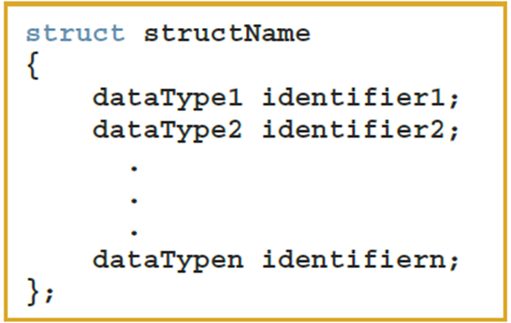
Records (structs) (1 of 3)
struct: a collection of a fixed number of components in which the components are accessed by name
The components may be of different types and are called the members of the struct
Syntax

Slide 5
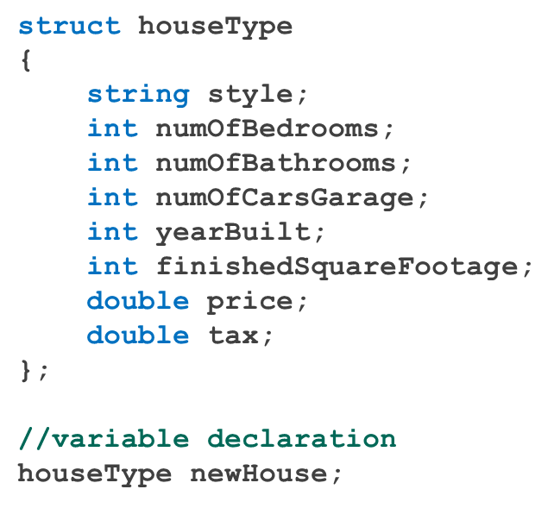
Records (structs) (2 of 3)
A struct is a definition, not a declaration
Must declare a variable of that type to use it

Slide 6
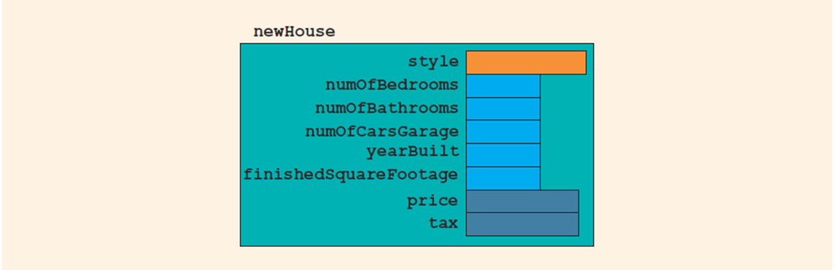
Records (structs) (3 of 3)
FIGURE 9-1 struct newHouse

Slide 7

Accessing struct Members (1 of 2)
Syntax to access a struct member:
The dot (.) is called the member access operator

Slide 8
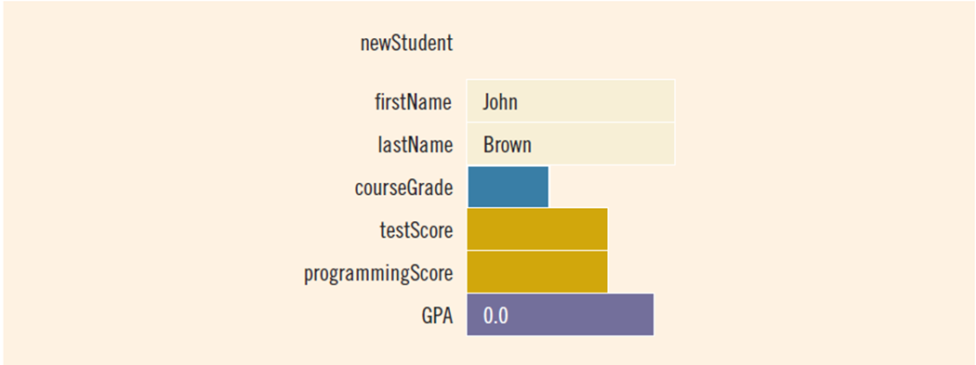
Accessing struct Members (2 of 2)
To initialize the members of newStudent:
newStudent.GPA = 0.0;
newStudent.firstName = "John";
newStudent.lastName = "Brown";
FIGURE 9-2 struct newStudent

Slide 9
Assignment (1 of 2)
Value of one struct variable can be assigned to another struct variable of the same type using an assignment statement
The statement:
student = newStudent;
copies the contents of newStudent into student

Slide 10
Assignment (2 of 2)
The assignment statement:
student = newStudent;
is equivalent to the following statements:
student.firstName = newStudent.firstName;
student.lastName = newStudent.lastName;
student.courseGrade = newStudent.courseGrade;
student.testScore = newStudent.testScore;
student.programmingScore = newStudent.programmingScore;
student.GPA = newStudent.GPA;

Slide 11
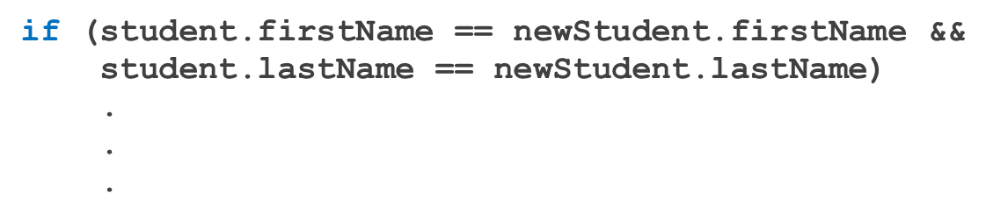
Comparison (Relational Operators)
Compare struct variables member-wise
No aggregate relational operations are allowed
To compare the values of student and newStudent:

Slide 12
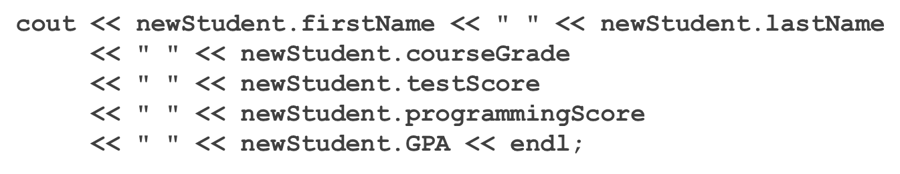
Input/Output
No aggregate input/output operations are allowed on a struct variable
Data in a struct variable must be read or written one member at a time
The following code would output newStudent contents:

Slide 13
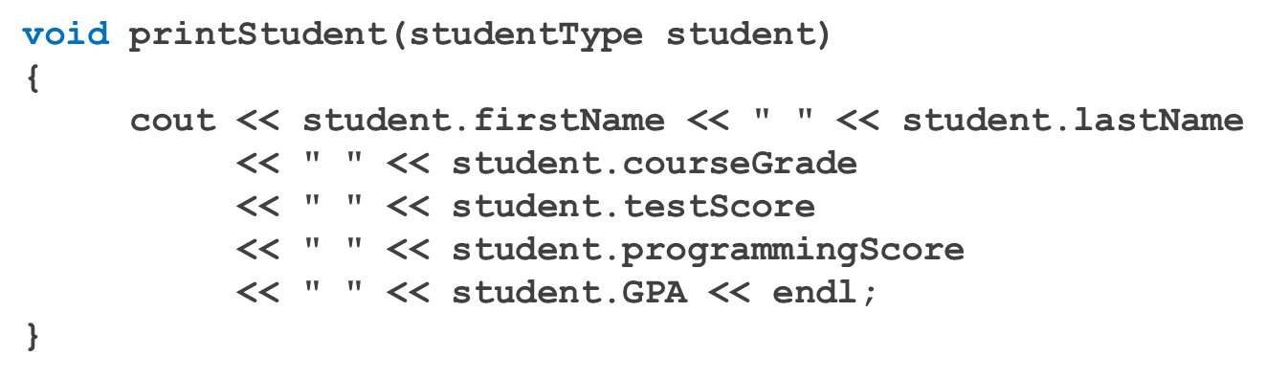
struct Variables and Functions
A struct variable can be passed as a parameter by value or by reference
A function can return a value of type struct
The following function displays the contents a struct variable of type studentType:

Slide 14
Arrays versus structs
TABLE 9-1 Arrays vs. structs
Data Type | Array | struct
Arithmetic | No | No
Assignment | No | Yes
Input/output | No (except strings) | No
Comparison | No | No
Parameter passing | By reference only | By value or by reference
Function returning a value | No | Yes

Slide 15
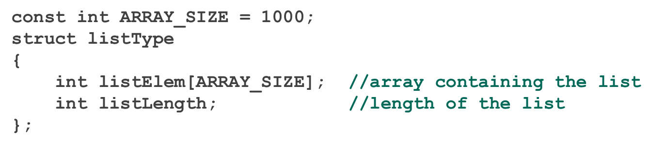
Arrays in structs (1 of 3)
Two items are associated with a list:
Values (elements)
Length of the list
Define a struct containing both items:

Slide 16
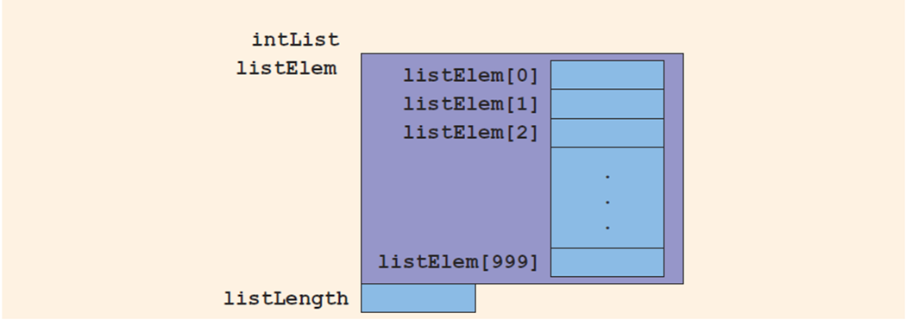
Arrays in structs (2 of 3)
FIGURE 9-5 struct variable intList

Slide 17
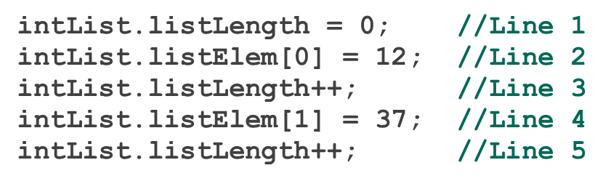
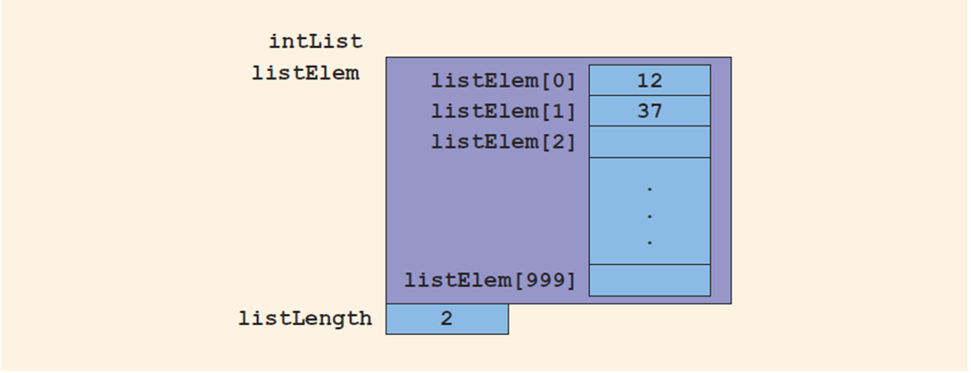
Arrays in structs (3 of 3)
Consider these statements and refer to the figure below showing the results following execution of the statements:
FIGURE 9-6 intList after the statements in Lines 1 through 5 execute

Slide 18
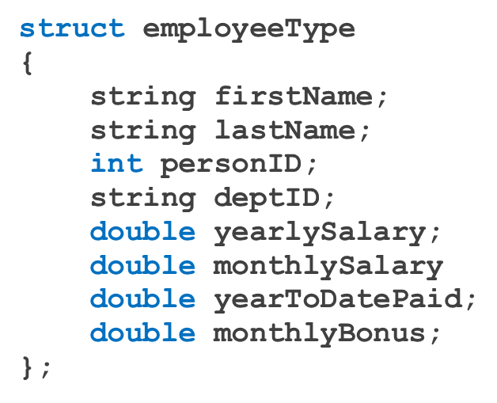
structs in Arrays (1 of 2)
Example

Slide 19
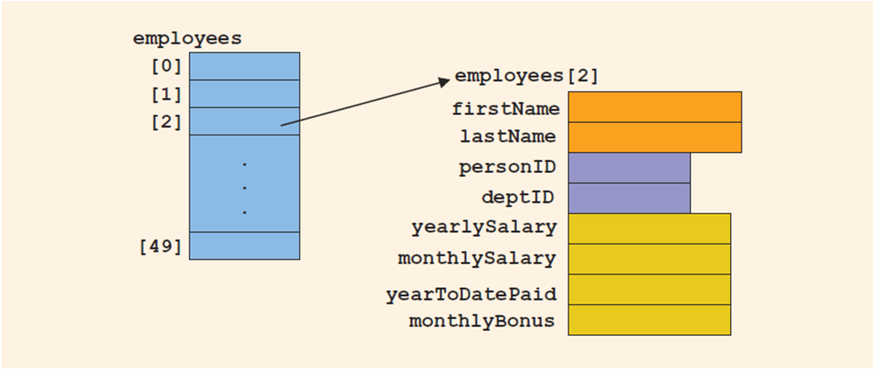
structs in Arrays (2 of 2)
employeeType employees[50]
Declares the array employees of 50 components of type employeeType
FIGURE 9-7 Array of employees

Slide 20
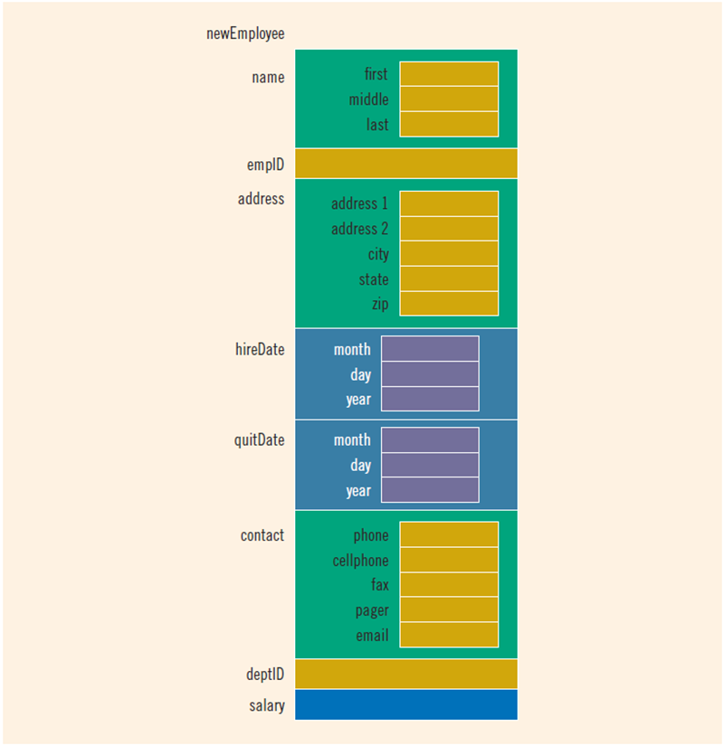
structs within a struct
FIGURE 9-8 struct variable newEmployee

Slide 21
Quick Review (1 of 2)
A struct is a collection of a fixed number of components
Components of a struct can be of different types
Called members
Accessed by name
struct is a reserved word
No memory is allocated for a struct
Memory is allocated only when variables are declared

Slide 22
Quick Review (2 of 2)
In C++, the dot (.) operator is called the member access operator
Used to access members of a struct
The only built-in operations on a struct are the assignment and member access operations
Neither arithmetic nor relational operations are allowed on structs
A struct can be passed by value or reference
A function can return a value of type struct
A struct can be a member of another struct

